Slide 1
Used Car Price Prediction
Submitted by
Yashna Shah

Slide 2
ACKNOWLEDGEMENT
I would like to express my deepest gratitude to my SME (Subject Matter Expert)Sapna Verma as well as Flip Robo Technologies who gave me the opportunity to do this project on Used Car Price Prediction, which also helped me in doing lots of research wherein I came to know about so many new things especially the data collection part.
Also, I have utilized a few external resources that helped me to complete the project. I ensured that I learn from the samples and modify things according to my project requirement.

Slide 3
PROBLEM STATEMENT
With the covid 19 impact in the market, we have seen lot of changes in the car market. Now some cars are in demand hence making them costly and some are not in demand hence cheaper. One of our clients works with small traders, who sell used cars. With the change in market due to covid 19 impact, our client is facing problems with their previous car price valuation machine learning models. So, they are looking for new machine learning models from new data. We have to make car price valuation model.

Slide 4
DATA COLLECTION PHASE
You have to scrape at least 5000 used cars data. You can scrape more data as well, it’s up to you. more the data better the model
In this section You need to scrape the data of used cars from websites (OLX, Car Dekho, Cars 24 etc.) You need web scraping for this. You have to fetch data for different locations. The number of
columns for data doesn’t have limit, it’s up to you and your creativity. Generally, these columns are Brand, model, variant, manufacturing year, driven kilometers, fuel, number of owners, location and at last target variable Price of the car. This data is to give you a hint about important variables in used car model. You can make changes to it, you can add or you can remove some columns, it completely depends on the website from which you are fetching the data.
Try to include all types of cars in your data for example- SUV, Sedans, Coupe, minivan, Hatchback.

Slide 5
MODEL BUILDING PHASE
After collecting the data, you need to build a machine learning model. Before model building do all data pre-processing steps. Try different models with different hyper parameters and select the best model. Follow the complete life cycle of data science. Include all the steps below.
1. Data Cleaning
2. Exploratory Data Analysis
3. Data Pre-processing
4. Model Building
5. Model Evaluation
6. Selecting the best model

Slide 6
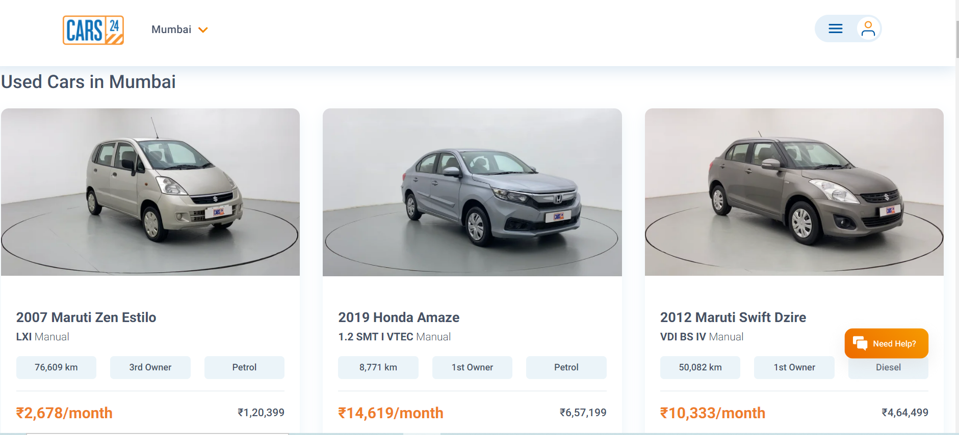
WEB SCRAPING

Slide 7
DATA PREPROCESSING
Importing the necessary dependencies and libraries.
Reading the CSV file and converted into data frame.
Checking the data dimensions for the original dataset.
Looking for null values and accordingly fill the missing data.
Checking the summary of the dataset.
Checking unique values.
Checking all the categorical columns in the dataset.

Slide 8
DATA PREPROCESSING
Visualizing each features using matplotlib and seaborn.
Performing encoding using the label encoder on categorical features.
Checking for correlation in a heatmap.
Checking for Outliers/Skewness using boxen plot and distribution plot.
Perform Scaling using Standard Scaler method.
Checking for the final dimension of dataset to confirm the input details.
Creating train test split and the best random state

Slide 9
DATA PREPROCESSING
Checking for multi collinearity using VIF.
Performed PCA
Performed Feature Importance using ExtraTrees Regression.

Slide 10
TECHNOLOGY USED
Hardware technology being used.
RAM : 16 GB
CPU : 11th Gen Intel(R) Core(TM) i5-1135G7 @ 2.40GHz 2.42 GHz
GPU : intel Iris Graphics
Software technology being used.
Programming language : Python
Distribution : Anaconda Navigator
Browser based language shell : Jupyter Notebook
Libraries/Packages specifically being used.
Pandas, NumPy, matplotlib, seaborn, scikit-learn

Slide 11
EDA
First I have imported the necessary libraries and loaded the entire dataset in our Jupyter Notebook . Then I checked the shape of our dataset and found that we have a total of 3658 rows and 9 different columns.
We had null values in our dataset, which we imputed using mode.
There were no duplicate data in our dataset.
By checking the data types I came to know that our data set consists of columns having only object datatype even those there were numeric information present.

Slide 12
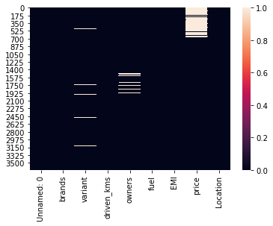
GRAPHICAL REPRESENTATION
Heatmap with Null Values

Slide 13
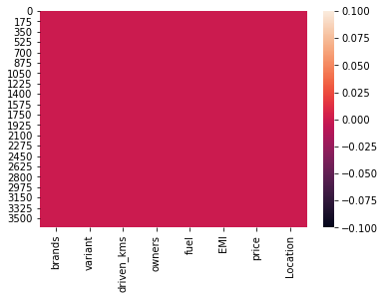
Contd…
Heatmap after filling null values

Slide 14
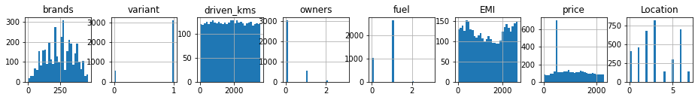
Contd..
Histogram

Slide 15
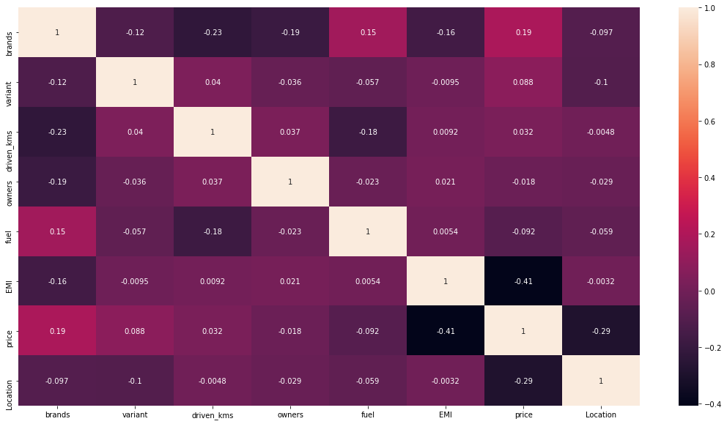
Contd..
Correlation heatmap

Slide 16
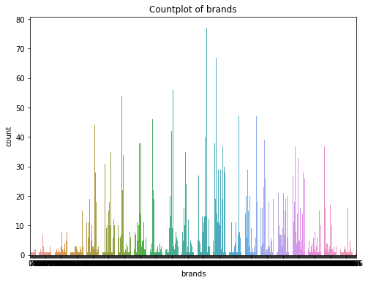
Contd…
Countplot of Brands column

Slide 17
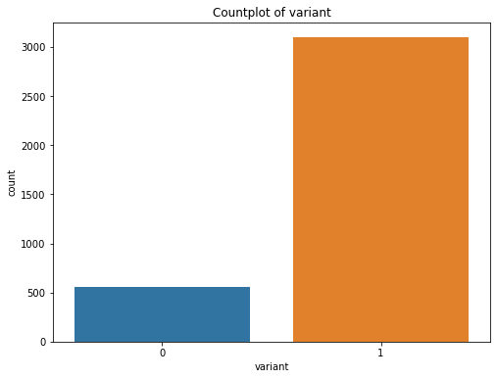
Contd..
Countplot of variant column

Slide 18
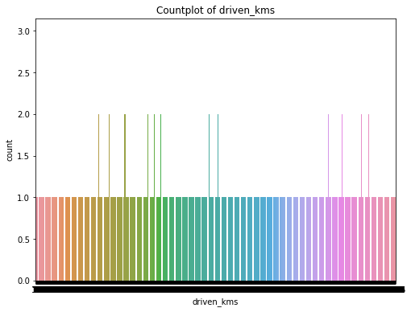
Contd…
Countplot of Driven_kms

Slide 19
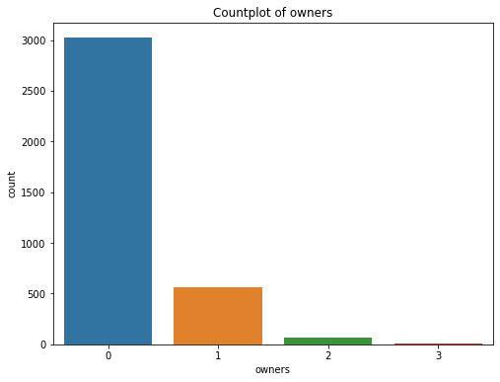
Contd…
Countplot of Owners

Slide 20
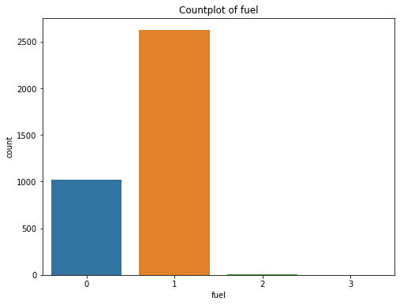
Contd….
Countplot of Fuel column

Slide 21
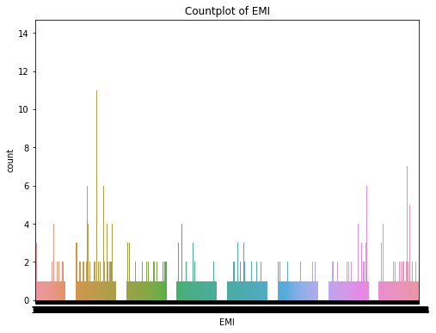
Contd…
Countplot of EMI

Slide 22
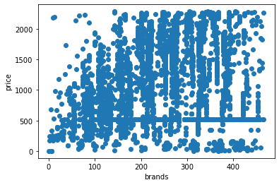
Contd…
Scatterplot between all features and target variable

Slide 23
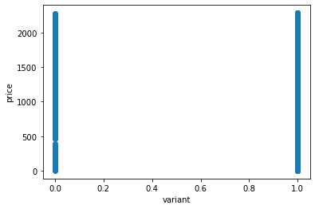
Contd..

Slide 24
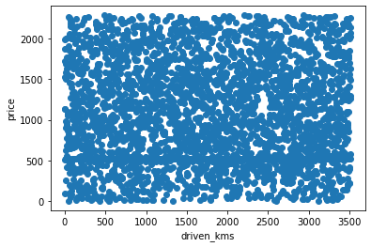
Contd…

Slide 25
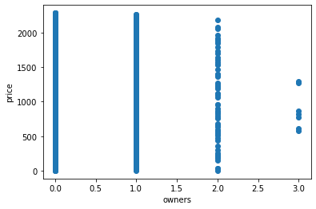
Contd..

Slide 26
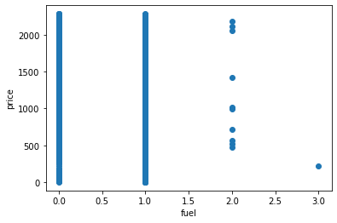
Contd…

Slide 27
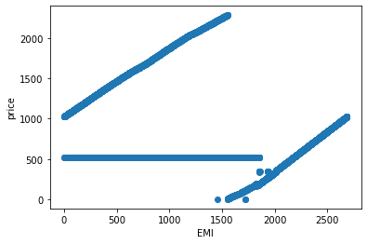
Contd..

Slide 28
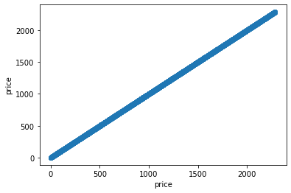
Contd..

Slide 29
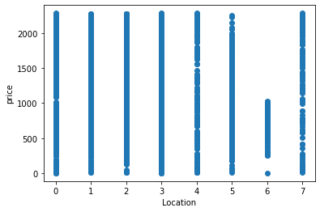
Contd..

Slide 30
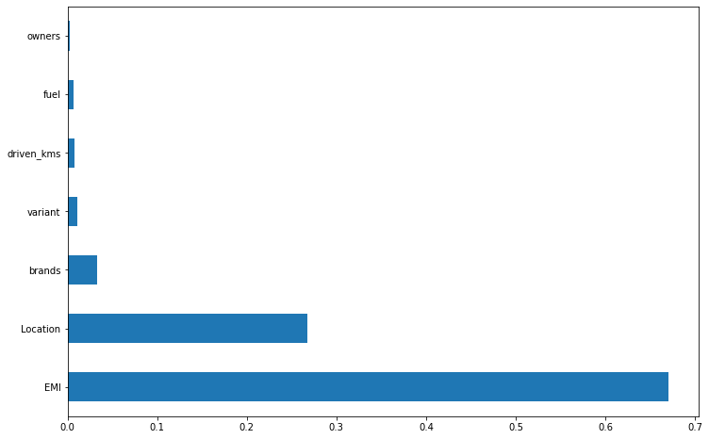
FEATURE IMPORTANCE

Slide 31
MODEL BUILDING
Machine Learning models used
Linear Regression
SGD Regressor
LASSO Regressor
RIDGE Regressor
Random Forest Regressor

Slide 32
EVALUATION AND HYPERPARAMETER TUNING
The key metrics used here were:
R2 score
Cross Validation Score
MAE
MSE
RMSE
We tried to find out the best parameters list to increase our accuracy scores by using Hyperparameter Tuning. In order to achieve a higher score we used the RandomizedSearch CV method with 5 folds.

Slide 33
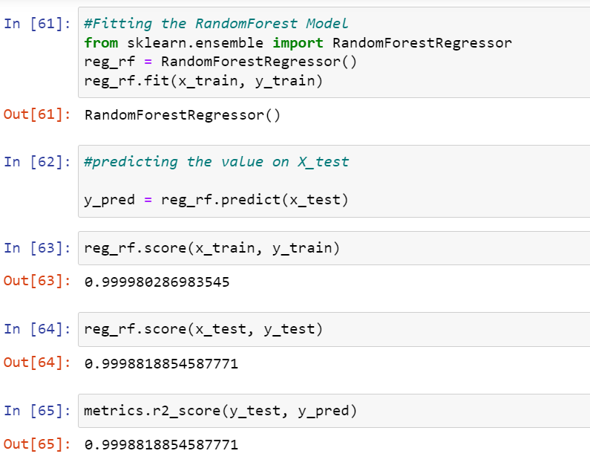
Best Model Selected
Random Forest Regressor gave us the best accuracy score of 99%.

Slide 34
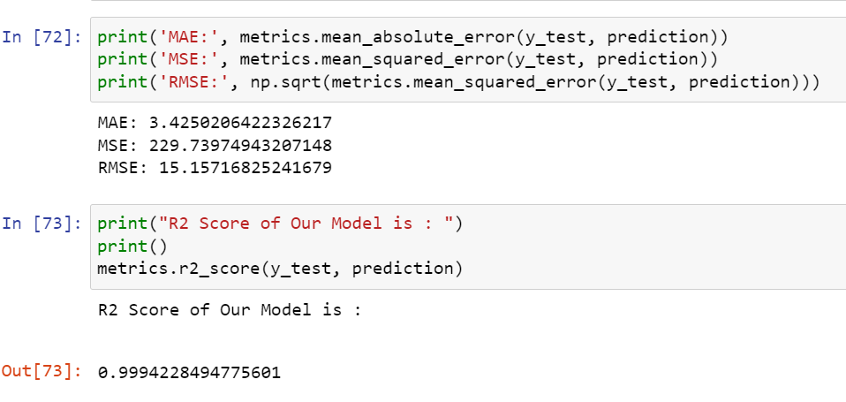
METRICS USED

Slide 35
CONCLUSION
After the completion of this project, we got an insight on how to collect data, pre-processing the data, analyzing the data and building a model. First, we collected the used cars data from different website Cars 24 and it was done by using Web Scraping.
The framework used for web scraping was Selenium, which has an advantage of automating our process of collecting data. We collected almost 3500 of data which contained the price and other related features of used cars. Then the scrapped data was combined in a single data frame and saved in a csv file so that we can open it and analyze the data and build the model with best accuracy.

